Slide 1
TRIZ Principles

Slide 2
References
https://www.quality-assurance-solutions.com/triz-training-on-line.html
https://www.quality-assurance-solutions.com/TRIZ-training.html
https://www.quality-assurance-solutions.com/TRIZ-Separation-Principles.html
https://www.quality-assurance-solutions.com/Triz.html
https://www.quality-assurance-solutions.com/What-is-Triz.html
https://www.quality-assurance-solutions.com/Triz-Inventive-Principles-9.html
https://www.quality-assurance-solutions.com/Triz-Inventive-Principles-1.html
https://www.quality-assurance-solutions.com/Triz-Inventive-Principles-17.html
https://www.quality-assurance-solutions.com/TRIZ-Inventive-Principles-25.html
https://www.quality-assurance-solutions.com/TRIZ-Inventive-Principles-33.html
https://www.quality-assurance-solutions.com/8D-Problem-Solving.html

Slide 3
References
https://slideplayer.com/slide/4712408/ TRIZ: The Theory of Inventive Problem Solving
https://slideplayer.com/slide/3960914/ Theory of Solving Problems Inventively)
https://www.ideaconnection.com/interviews/00353-Inventive-Principles-Illustrated-Part-1.html
https://www.ideaconnection.com/interviews/00351-Something-that-Does-Not-Exist.html
https://www.ideaconnection.com/interviews/00350-Inventive-Problem-Solving.html
https://www.ideaconnection.com/resources/

Slide 4
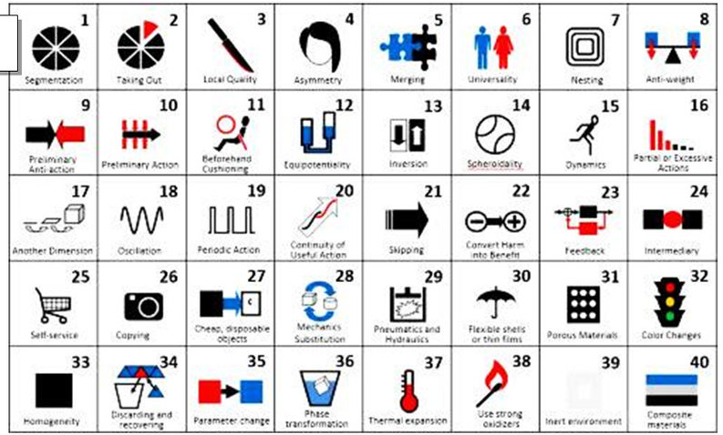

Slide 5
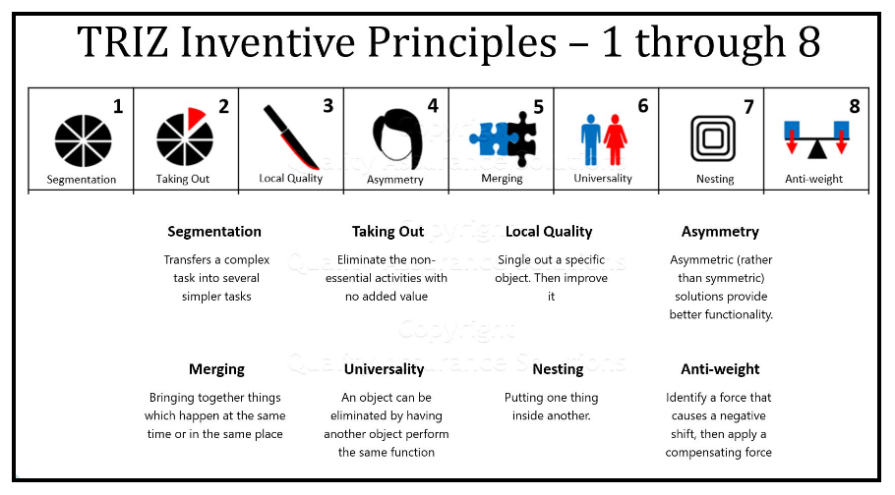

Slide 6
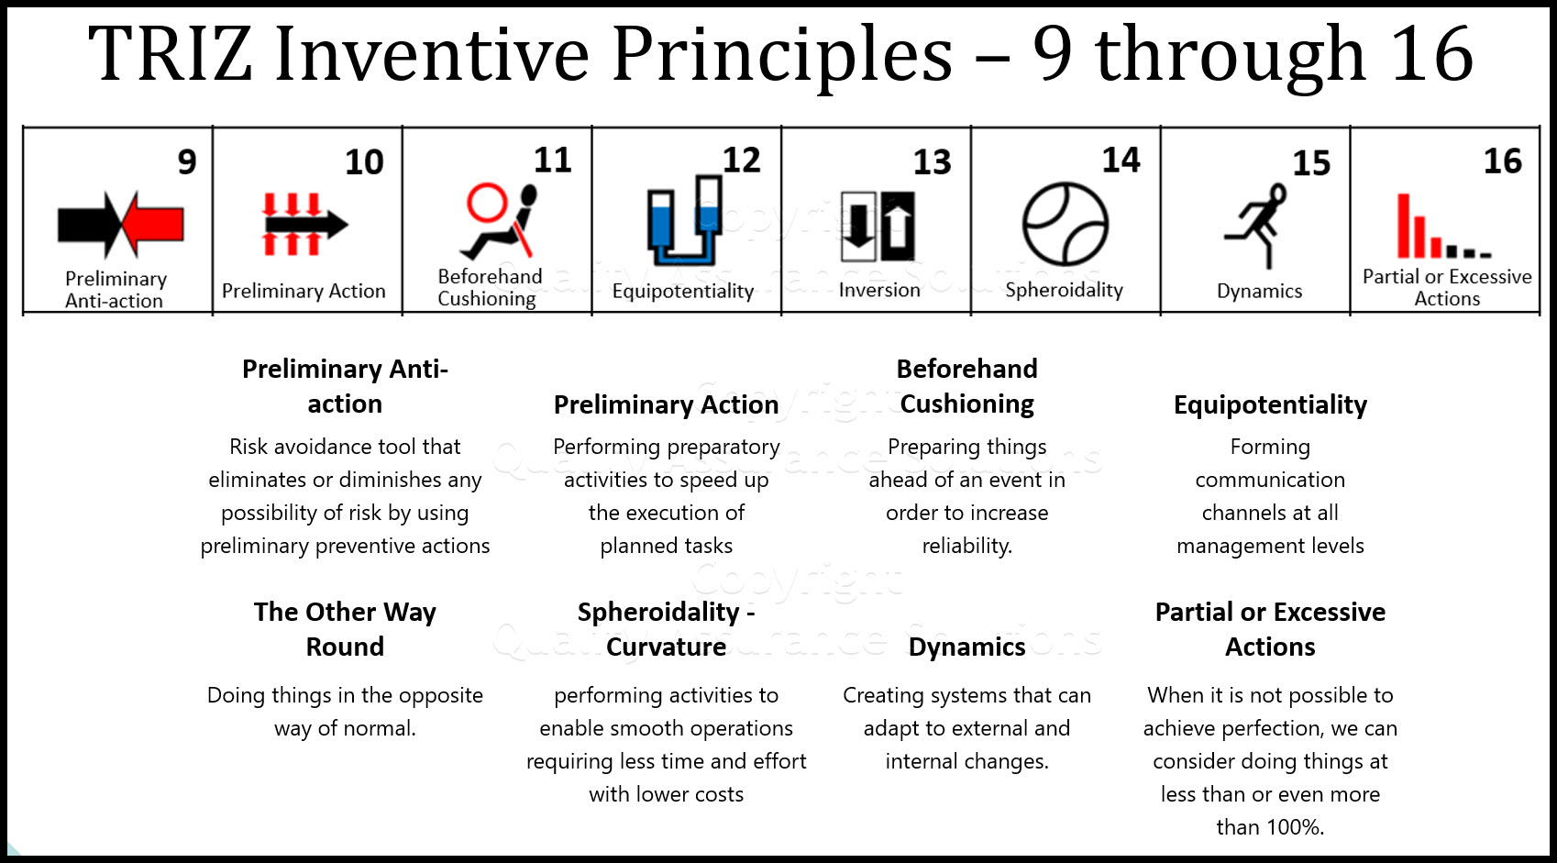

Slide 7
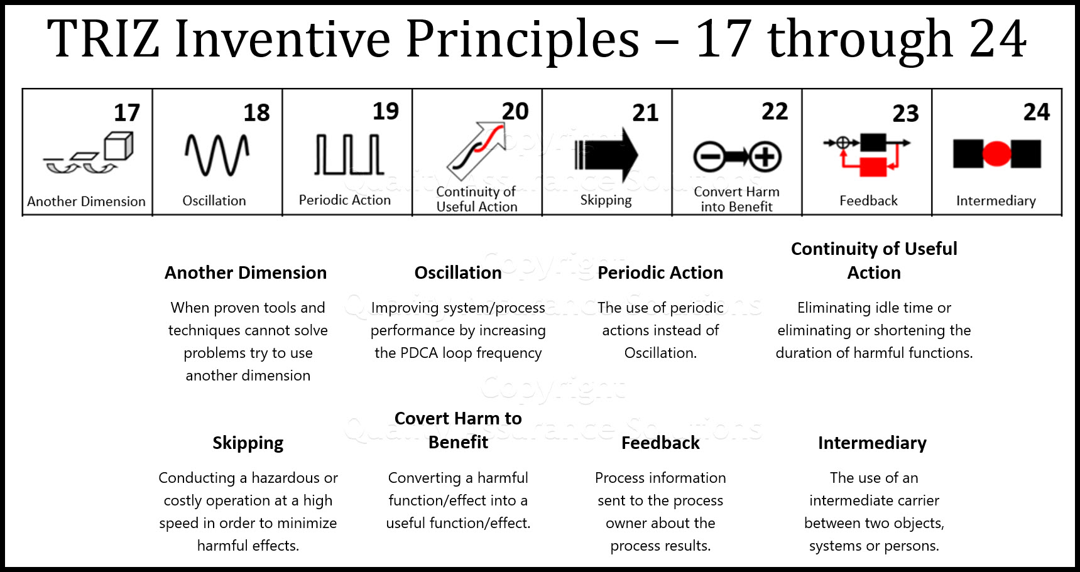

Slide 8
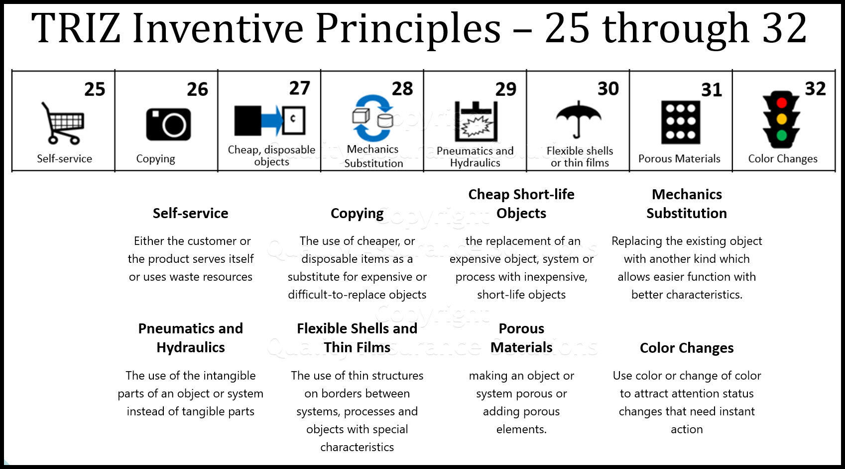

Slide 9
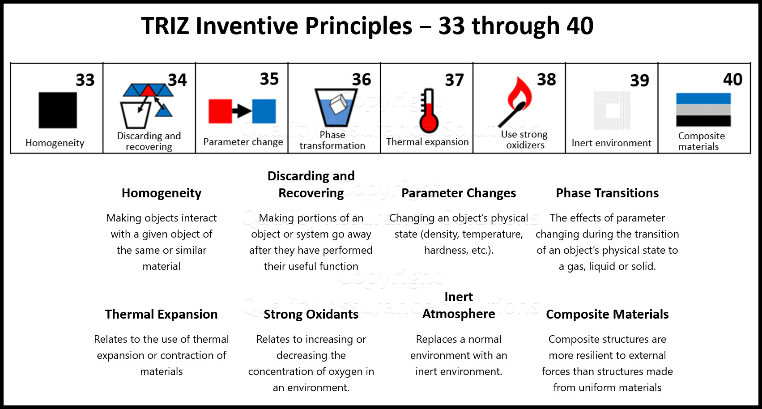

Slide 10
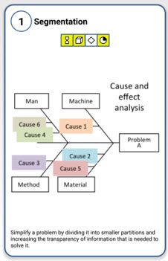
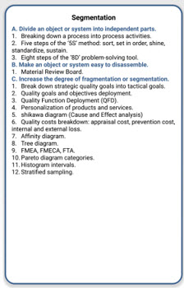
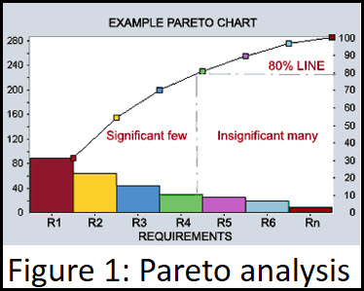
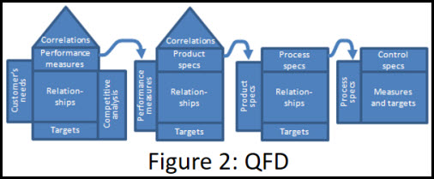
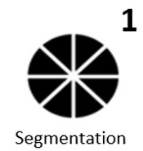
Segmentation
Segmentation transfers a complex task into a number of simpler tasks that are easier to solve.
From very simple but effective tools like Pareto analysis (fig 1) to very complex tools like Quality Function Deployment (fig2).

Slide 11
Segmentation
A. Divide an object into independent parts
− Different focal length lenses for a camera
− Gator-grip socket spanner
− Multi-pin connectors
− Multiple pistons in an internal combustion engine
− Multi-engined aircraft
− Stratification of different constituents inside a chemical process vessel

Slide 12
Segmentation
B. Make an object sectional - easy to assemble or disassemble
− Rapid-release fasteners for bicycle saddle/wheel/etc
− Quick disconnect joints in plumbing and hydraulic systems
− Single fastener V-band clamps on flange joints
− Loose-leaf paper in a ring binder

Slide 13
Segmentation
C. Increase the degree of fragmentation or segmentation
− Multiple control surfaces on aerodynamic structures
− 16 and 24 valve versus 8 valve internal combustion engines
− Multi-zone combustion system
− Build up a component from layers (e.g. stereo-lithography, welds, etc)

Slide 14
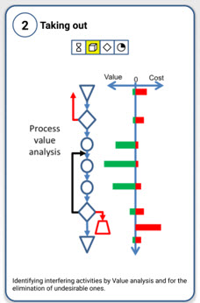
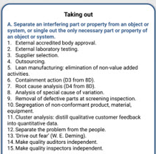
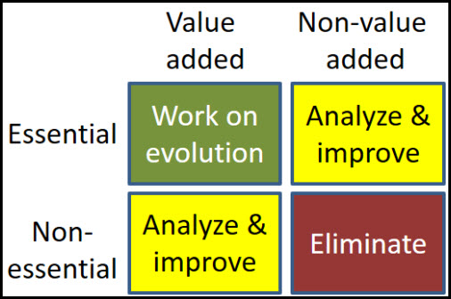
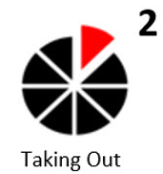
2. Taking Out
Perform a value analysis of each process step.
Determine the created added value and the costs to achieve that value for each step.
Using the inventive principle ‘Taking Out’, eliminate the non-essential activities with no added value and those with high costs.

Slide 15
Taking out
A. Extract the disturbing part or property from an object
− Non-smoking areas in restaurants or in railway carriages
− Children-only areas in public places and home
− Sunday school
− Public bars and lounge bars in pubs
− Women or men only bars / waiting rooms
− Air Conditioning in the room where you want it with the noise of the
system outside the room
(The contradiction here is noise vs coolness- the cooler it gets the noisier it
gets- this solves the contradiction by putting the noise elsewhere )

Slide 16
Taking out
B. Extract the only necessary part (or property) of an object
− Scarecrow
− Sound of a barking dog (with no dog) as a burglar alarm
− Economy class on planes (travel but no frills)
(This involves understanding all the functionality and selecting only what you want- e.g. windows provide ventilation and light - with air conditioning you may not need windows which open)

Slide 18
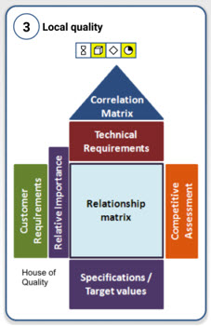
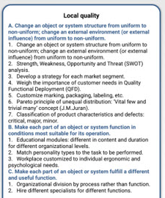
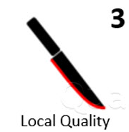
3. Local Quality
‘Local Quality’ means to single out a specific object (i.e. product, service, processes, process activities or tools). Then improve it to better provide its function or place it in an environment so that it is optimally useful.
A House of Quality Matrix aids in defining a product to meet customer needs. It help defines the relationship between customer requirements and the product capabilities. It lays out the target parameters to make the product appealing to the customer and surpass the competition. This tool fosters teamwork during design and process planning operations.

Slide 19
Local quality
A. Change of an object's structure from uniform to non-uniform
− Reduce drag on aerodynamic surfaces by adding riblets or 'shark-skin' protrusions
− Moulded hand grips on tools
− Drink cans shaped to facilitate stable stacking
− Material surface treatments / coatings - plating,
− Erosion / corrosion protection, case hardening, non-stick, etc

Slide 20
Local quality
B. Change an action or an external environment (or external influence) from uniform to non-uniform
− Introduce turbulent flow around an object to alter heat transfer
Properties
− Strobe lighting
− Take account of extremes of weather conditions when designing
outdoor systems
− Use a gradient instead of constant temperature, density, or pressure

Slide 21
Local quality
C. Make each part of an object function in conditions most suitable for its
operation
− Freezer compartment in refrigerator
− Different zones in the combustion system of an engine
− Night-time adjustment on a rear-view mirror
− Lunch box with special compartments for hot and cold solid foods and
for liquids

Slide 22
Local quality
D. Make each part of an object fulfil a different and/or complementary useful function
− Swiss-Army knife
− Combined can and bottle opener
− Sharp and blunt end of a drawing pin
− Rubber on the end of a pencil
− Hammer with nail puller

Slide 23
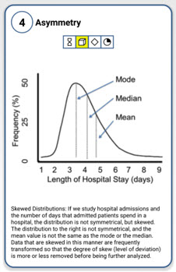
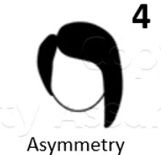

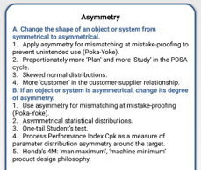
4. Asymmetry
Symmetric solutions might be more appealing to the human eye, but occasionally asymmetric solutions might provide better functionality.
This Logitech TrackMan Wheel Mouse with an asymmetric, right-handed design mouse is better suited to be used by a right-handed person but is almost unusable for a left-handed person.

Slide 24
Asymmetry
A. Change the shape or properties of an object from symmetrical to asymmetrical
− Asymmetrical funnel allows higher flow-rate than normal funnel
− Put a flat spot on a cylindrical shaft to attach a locking feature
− Oval and complex shaped O-rings
− Coated glass or paper
− Electric Plug
− Introduction of angled or scarfed geometry features on component edges
− Cutaway on a guitar improves access to high notes
− Spout of a jug
− Cam
− Ratchet
− Aerofoil – asymmetry generates lift
− Eccentric drive
− Keys

Slide 25
Asymmetry
B. Change the shape of an object to suit external asymmetries
(e.g. ergonomic features)
− Human-shaped seating, etc
− Design for left and right handed users
− Finger and thumb grip features on objects
− Spectacles
− Car steering system compensates for camber in road
− Wing design compensated for asymmetric flow produced by propeller
− Turbomachinery design for boundary layer flows (‘end-bend’)
C. If an object is asymmetrical, increase its degree of asymmetry
− Use of variable control surfaces to alter lift properties of an aircraft wing
− Special connectors with complex shape/pin configurations to ensure
correct assembly
− Introduction of several different measurement scales on a ruler

Slide 26
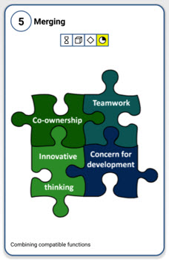
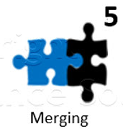
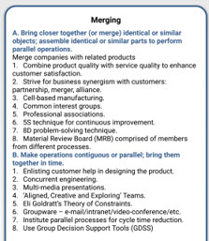
5. Merging
The principle of merging or combining means bringing together things which happen at the same time or in the same place. For example, when designing QMS, several tools can be combined into a powerful method. An element of the QMS is corrective action.
use the Pareto analysis to separate vital problems from the trivial many.
8D and 4M finds the root causes of a certain problem
Use a tree diagram to define the corrective actions and the corresponding resources needed to implement these corrective actions.

Slide 27
Merging
A. Bring closer together (or merge) identical or similar objects or operations in space
− Automatic rifle / machine gun
− Multi-colour ink cartridges
− Multi-blade razors
− Bi-focal lens spectacles
− Double / triple glazing
− Strips of staples
− Catamaran / trimaran

Slide 28
Merging
B. Make objects or operations contiguous or parallel; bring them together in time
− Combine harvester
− Manufacture cells
− Grass collector on a lawn-mower
− Mixer taps
− Pipe-lined computer processors perform different stages in a calculation simultaneously
− Vector processors perform the same process on several sets of data in a single pass
− Fourier analysis – integration of many sine curves

Slide 29
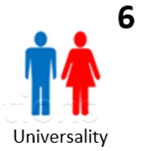
6. Universality
The inventive principle ‘Universality’ is used where objects can perform multiple functions. It is particularly useful where an object can be eliminated by having another object perform the same function.
For example, when integrating ISO 9001 and ISO 14001 requirements there are a number of procedures that apply to both standards.
documents and records control procedure
internal audit procedure
procedure to control non-conformities
corrective and preventive action procedure.

Slide 30
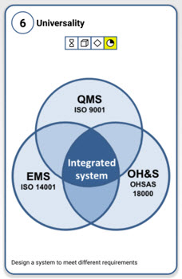
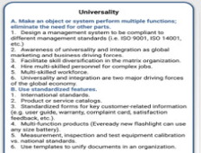

Slide 31
Universality
A. Make an object perform multiple functions; eliminate the need for other parts
− Child's car safety seat converts to a pushchair
− Home entertainment centre
− Swiss Army knife
− Grill in a microwave oven
− CD used as a storage medium for multiple data types
− Cleaning strip at beginning of a cassette tape cleans tape heads
− Cordless drill also acts as screwdriver, sander, polisher, etc

Slide 32
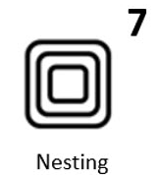
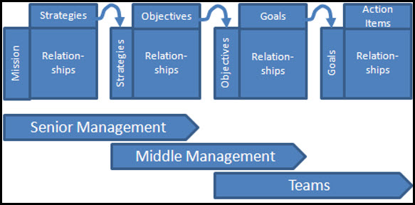
7. Nesting
Nesting means putting one thing inside another.
In management systems PDCA loops are nested so that there is a strategic PDCA loop with a one-year period and operational PDCA loop with a one week/month period.
Management processes are nested: the Sales Management process is nested in the Product Marketing Management process which in turn is part of a larger Strategic Management process.

Slide 33
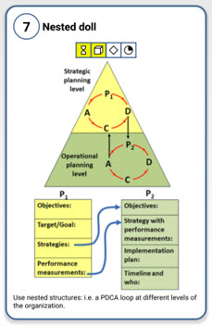
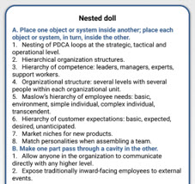

Slide 34
Nested Doll

Slide 35
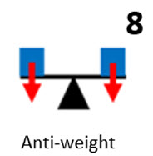
8. Anti-weight
Use Force Field Analysis to find which force causes the shift towards an undesirable direction, then apply a compensating force to steer the system in the opposite direction.
Examples:
Merge companies to take advantage of the other’s stronger capabilities.
Use international standards to set up requirements for a quality management system.

Slide 36
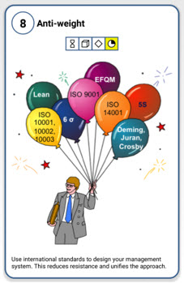
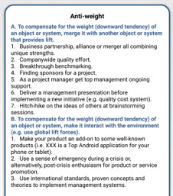

Slide 37
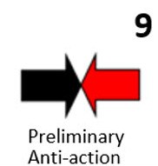

Slide 39
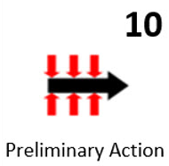

Slide 41
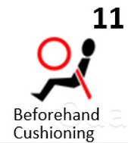

Slide 43
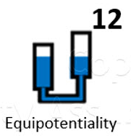

Slide 45
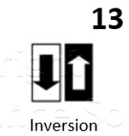

Slide 47
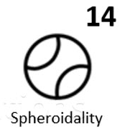

Slide 49
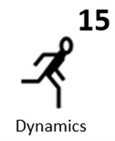

Slide 51
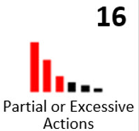

Slide 57
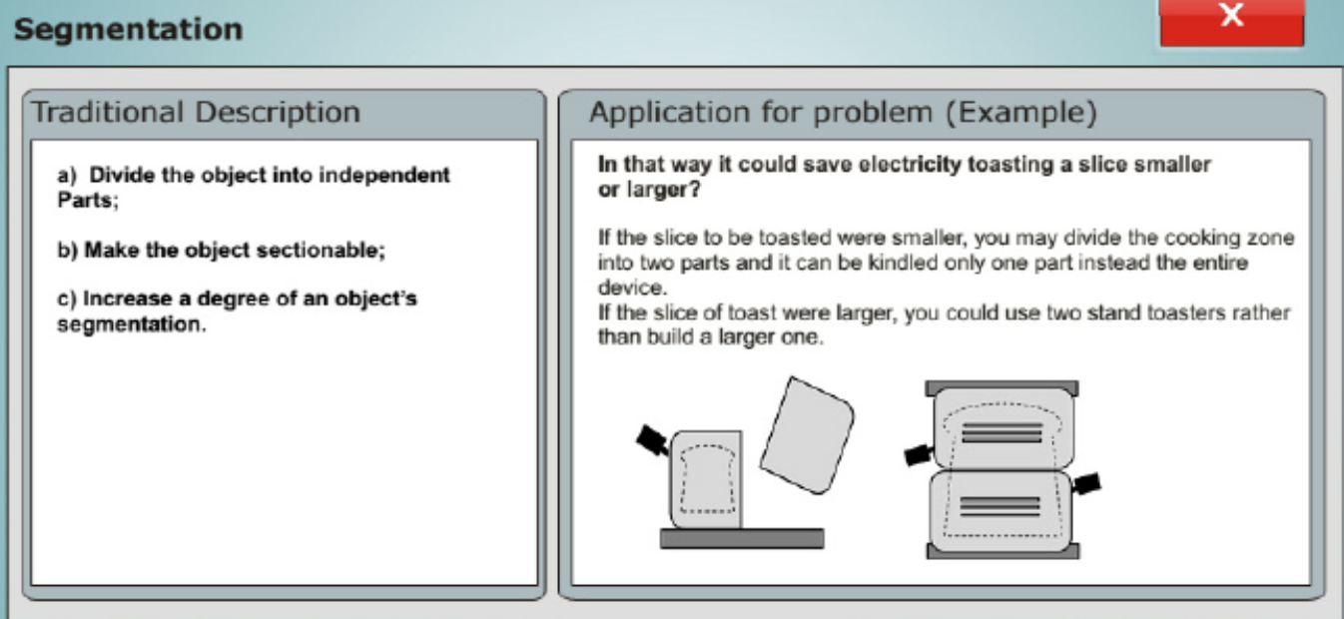

Slide 58
